Slide 1



CONTRA
A browser extension that extends your views
Presented by:
Gal Salman, Yoav Naaman & Tal Rojansky

Slide 2
OVERVIEW
01
02
03
Our Team
Personal Story
The Problem
04
05
06
The Solution
Timeline
Business Model

Slide 3


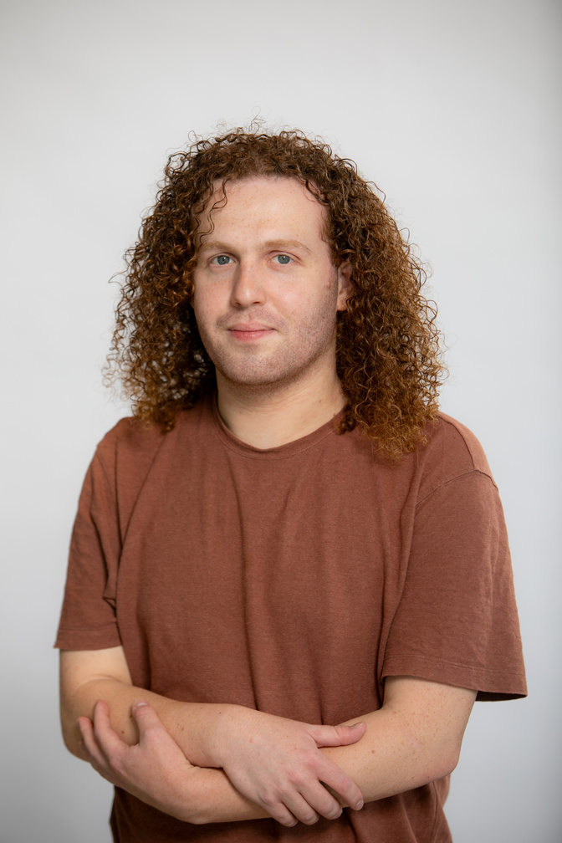
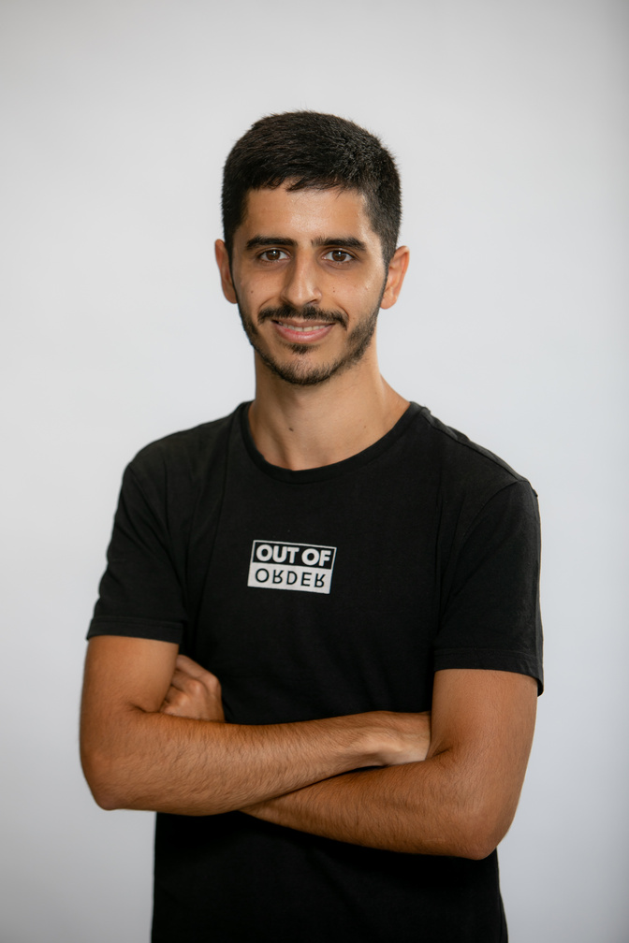
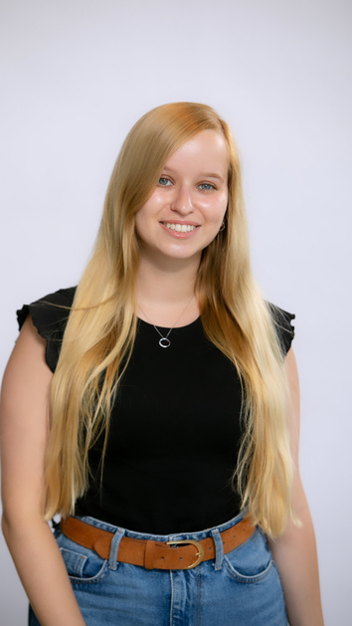
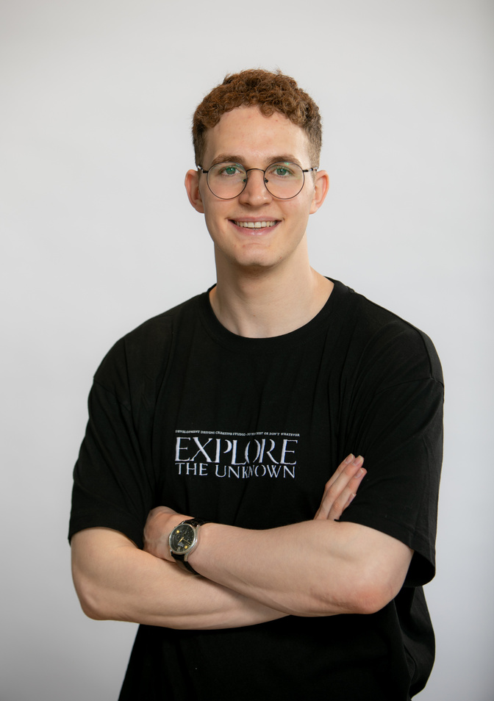
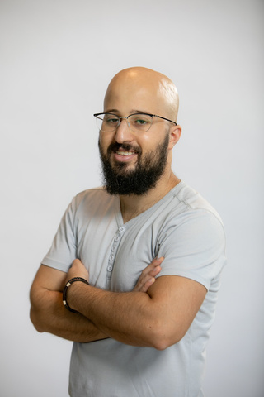
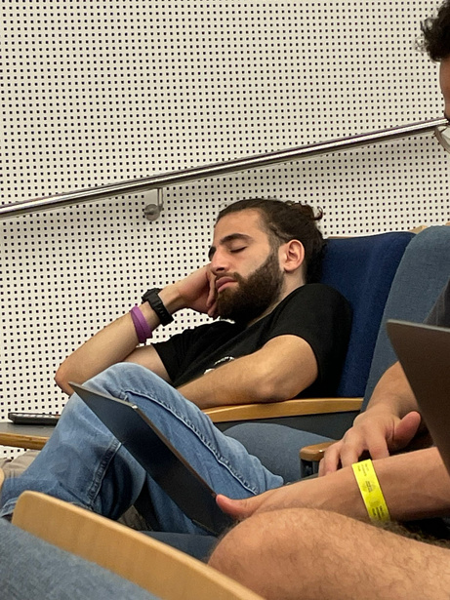

OUR TEAM
TAL
ROJANSKY
OMER
BITON
NOY NETANEL
KFIR
SPERBER
GAL
SALMAN
YOAV NAAMAN

Slide 4
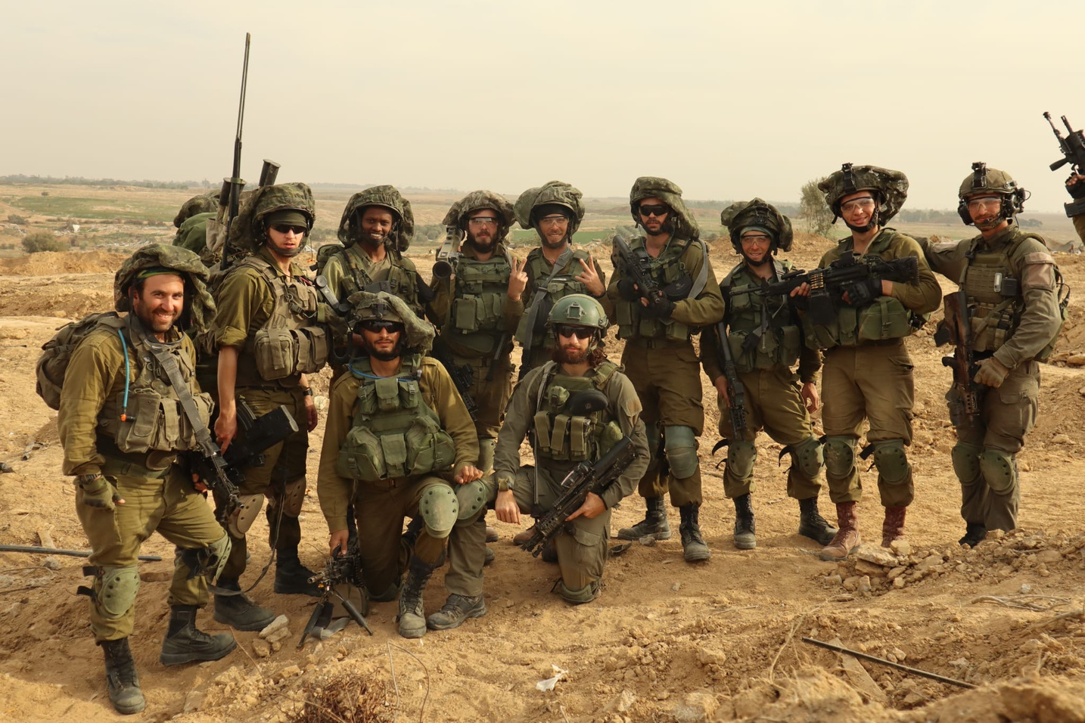

PERSONAL STORY
אליה יאנובסקי הי"ד,
ארי יחיאל זנילמן הי"ד

Slide 5


THE PROBLEM
Overwhelming amount of information
Difficult to determine the reliability
Sources may have political biases

Slide 6

THE SOLUTION
An AI based browser extension:
Find more articles with a different view on the same topic
Give more perspective
Get the bigger picture

Slide 7



No action needed
The extension jumps into action automatically
AI Based Algorithms
User-Friendly Interface
Continuous refinement for accurate misinformation detection
Intuitive design for seamless user experience

Slide 8


WHY NOW
Advanced Language Processing Technologies
Current Conflict in Israel
Abundance of Online Information

Slide 9

OUR COMPETITORS
Ground news
Allsides
Newscompare

Slide 10

WHY US?
Fits every news site as a browser extension
Easy to use
Better at handling smaller nuances

Slide 11
DEMO

Slide 12


TIMELINE

Slide 13

First step
Improving accuracy and response time
Expansion to more websites and social networks
Second
Third
Generate comments for specific sections in the article/post

Slide 14



CONCEPT IN BUSINESS
Business model
Provide our tool directly to social media platforms to improve the reliability of the information published in them.

Slide 15

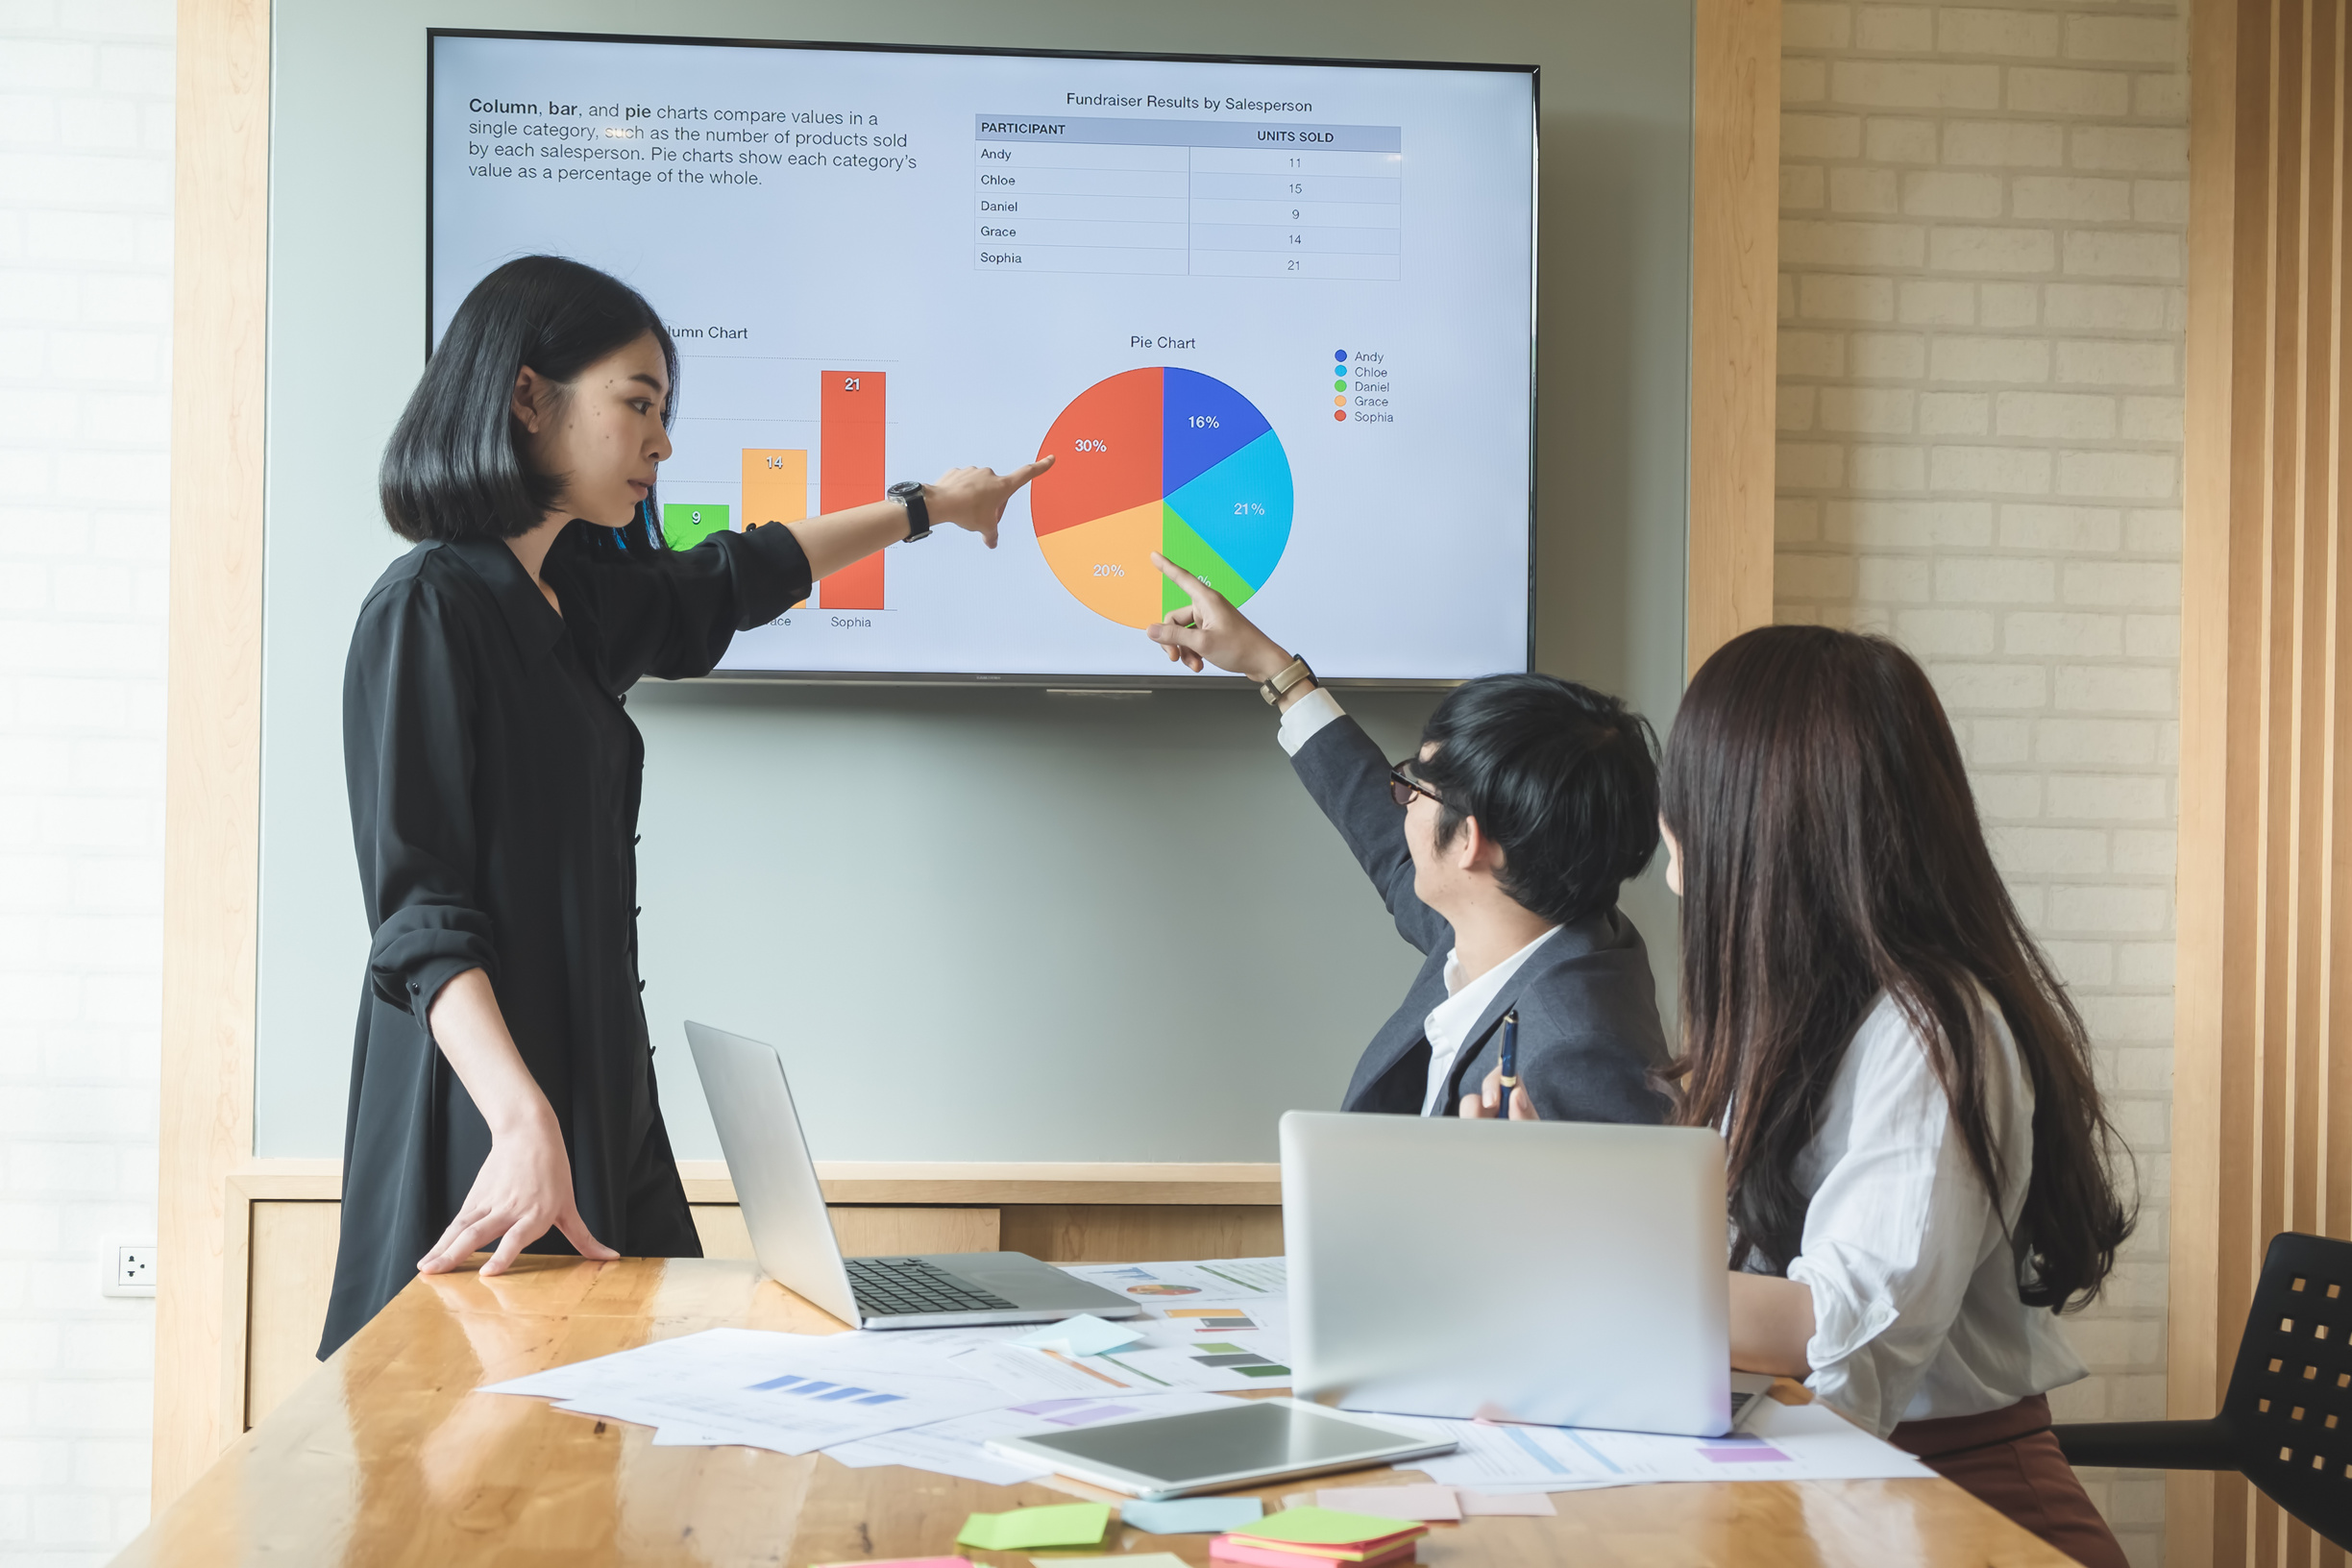

CONCEPT IN BUSINESS
Customer Value
Ensures reliable information and reduces misinformation.
Enhances credibility and user trust, while offering balanced perspectives to foster a well-informed and engaged community.

Slide 16


CONCEPT IN BUSINESS
User Value
Receive accurate information through verified content.
Gain diverse viewpoints, leading to more meaningful discussions and a better understanding of issues.

Slide 17
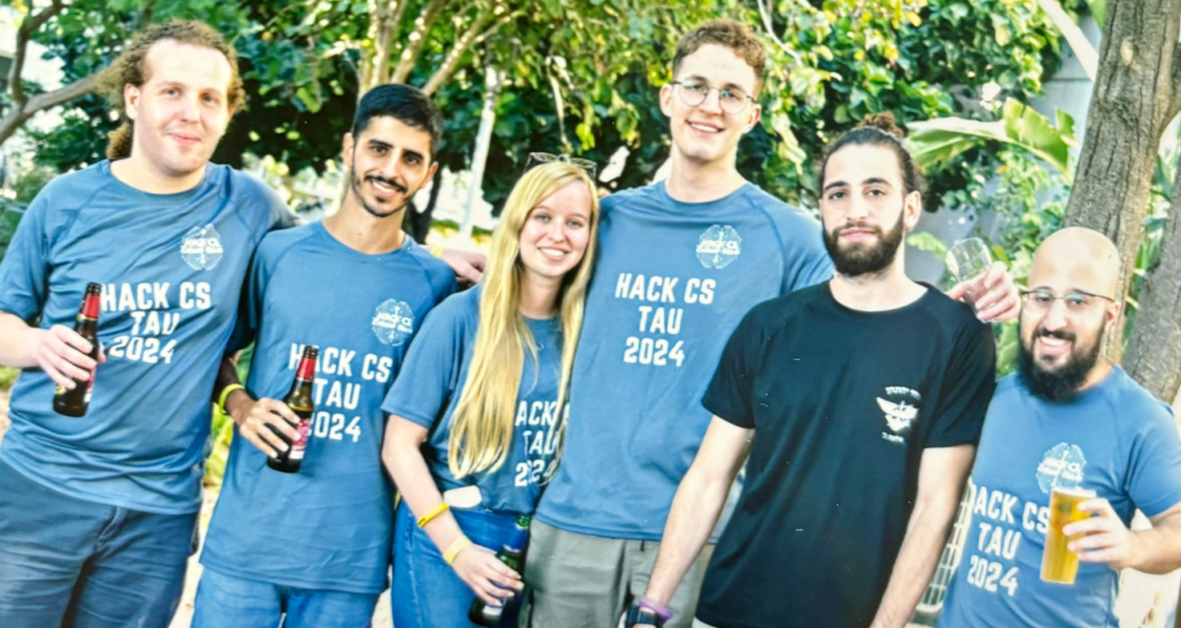

It’s time to widen your perspective
Thanks for your time
Connect with us.
054-2021337
Group 16

